Slide 1
Explanatory analytics
Data wrangling for multiple regression
Specifying a model
Visualizing the explanation
Checking the model

Slide 2
Ex2: Class walk through (cont)
Based on the Manheim case
http://aisel.aisnet.org/cais/vol1/iss1/20/
Use Manheim car sales data
manheim.csv
Visualize price, miles, and model
Viz - scatter

Slide 3
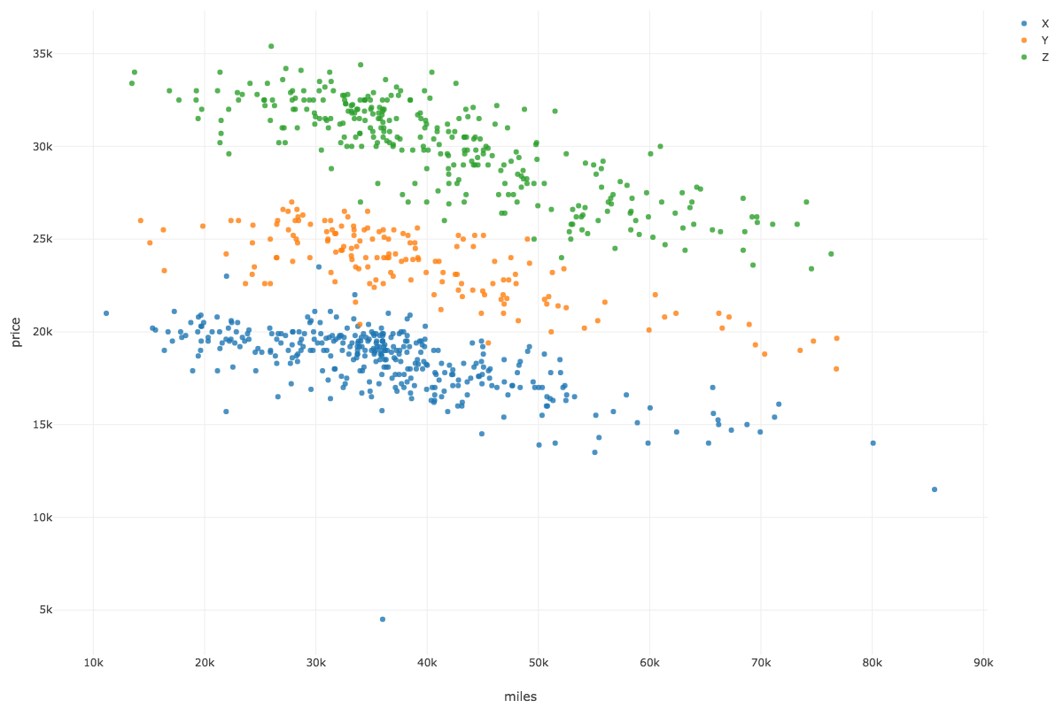

Slide 4
Ex2: Class walk through
Visualize price, miles, and sale
Viz - scatter

Slide 5
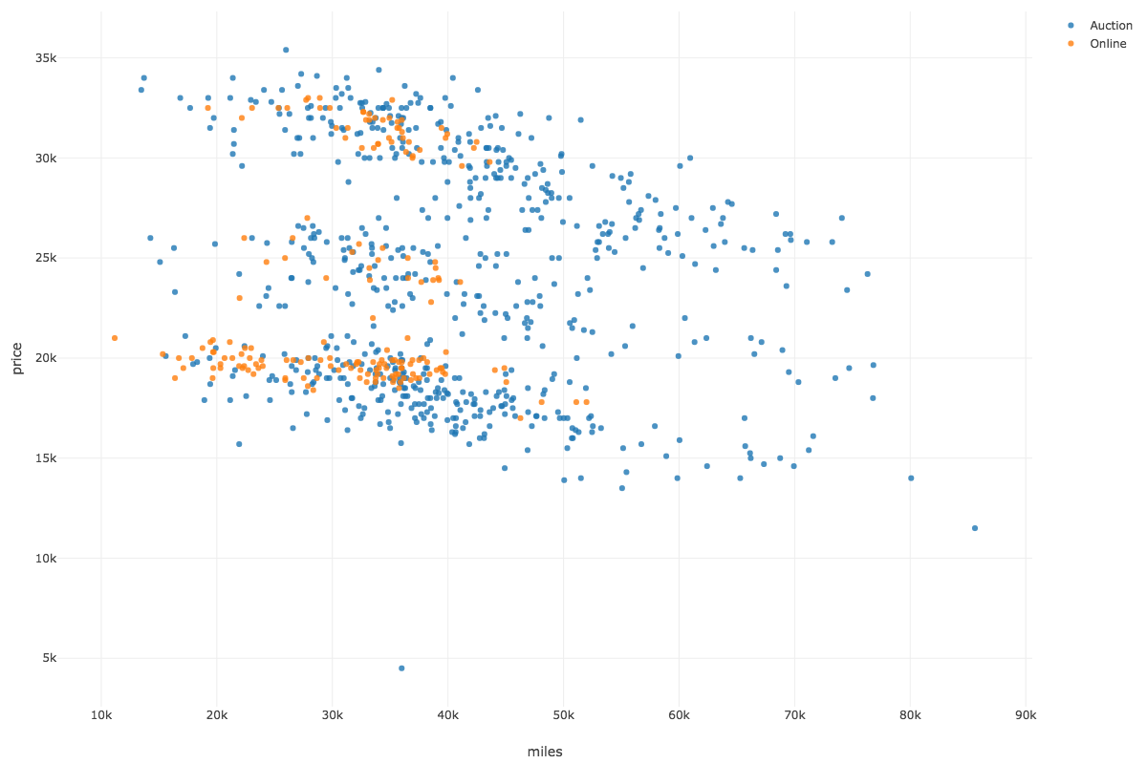

Slide 6
Ex2: Class walk through
Create a model of the form
price = f(miles, model, sale)
Build model – Build GLM
Explain the difference in the prices of cars
Term | Estimate | P-value
(Intercept) | 22887.74 | 0.00
miles | -0.13 | 0.00
modelZ | 12240.00 | 0.00
modelY | 5616.91 | 0.00
saleOnline | 591.75 | 0.00

Slide 7
Ex2: Class walk through
Create a model of the form
price = f(miles, model, sale)
Build model – Build GLM
Explain the difference in the prices of cars
Graph residuals
price vs residuals
Viz – Scatter
Are there any problems?

Slide 8
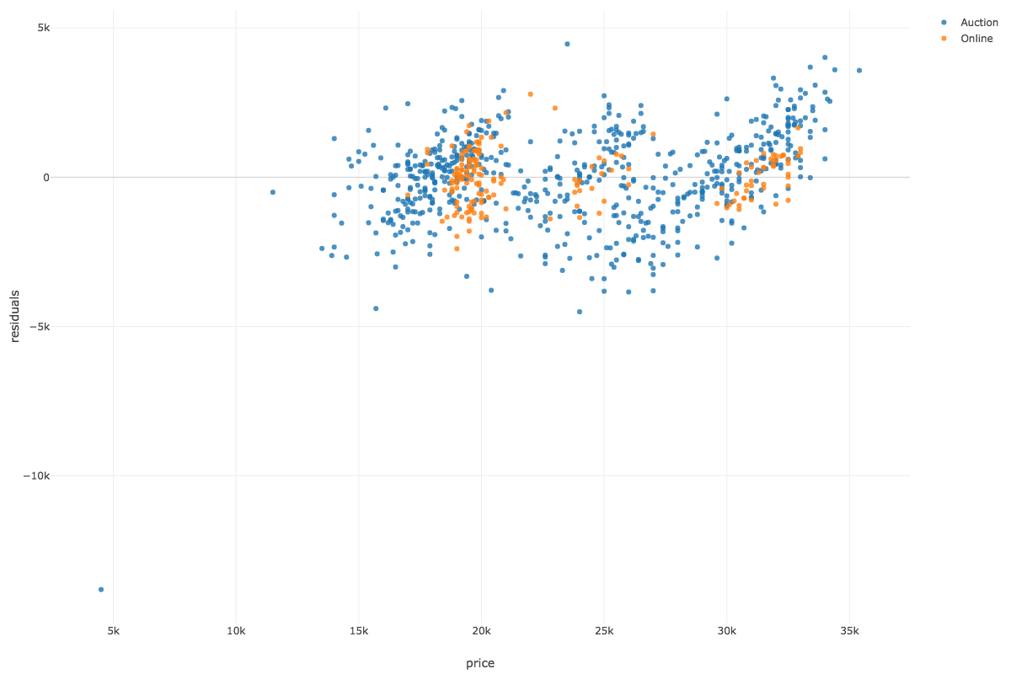

Slide 9
Predicting or setting price
Price = 22888 + -.13*miles + modelType + saleType

